Slide 1
ELA SOSR
Megan adams
Aaron nations
Jeniffer pitharoulis

Slide 2
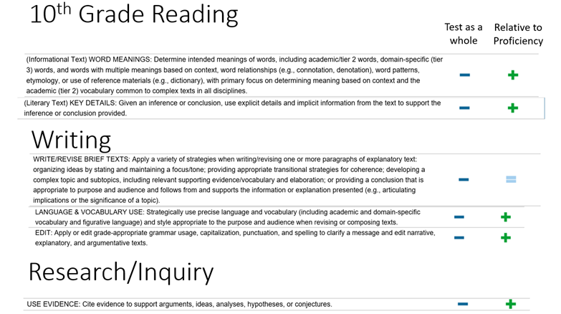
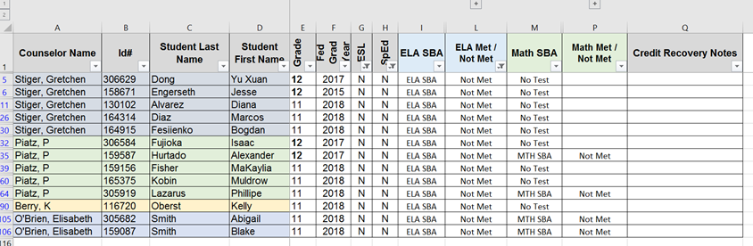
1. Data Disaggregation
2016 SBA Performance Strands
Notes:
Jeniffer’s Slide

Slide 3
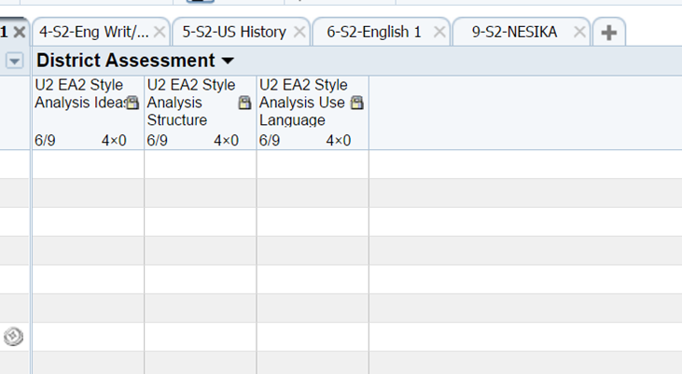
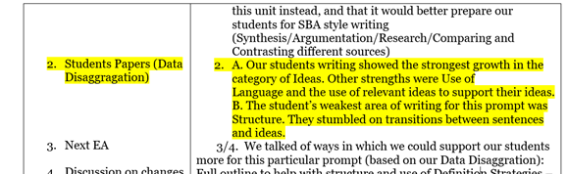
1. Data Disaggregation
SpringBoard Embedded Assessment Data Talks Gradebook Tool
Notes:
Aaron’s Slide: “strengths, weaknesses, trends”; “sub-groups for targeted instruction and monitoring”

Slide 4
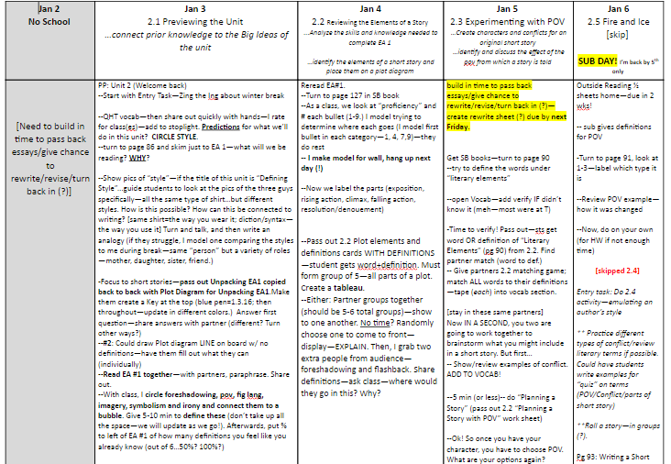
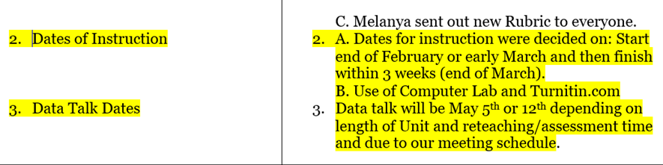
2. Timeline development
Common Assessment Calendaring and Unit Planning
Notes:
Aaron’s Slide: Use of LIF time to collaboratively make planning decisions

Slide 5

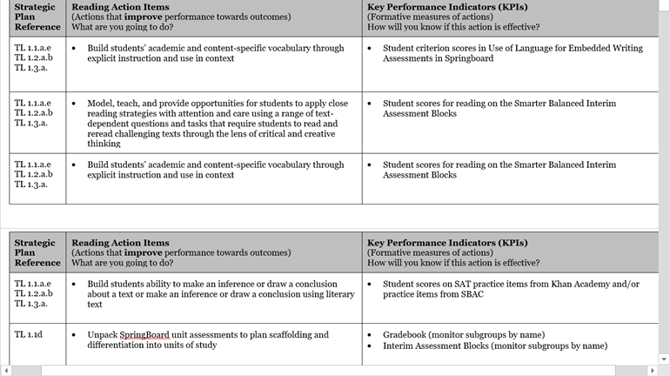
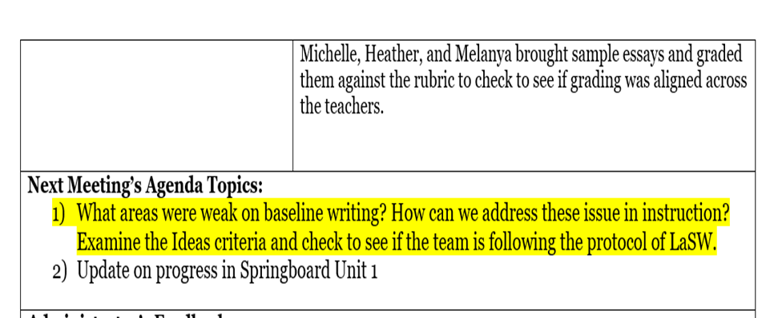
3. Instructional Focus
SIP Plan Decisions Data talk decisions
Notes:
Aaron’s Slide: Use of data to make decisions about what we need to teach, how plan to get there.

Slide 6
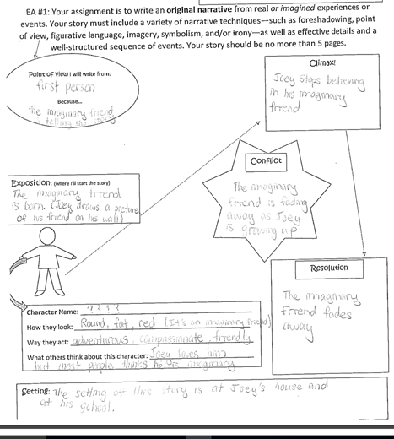

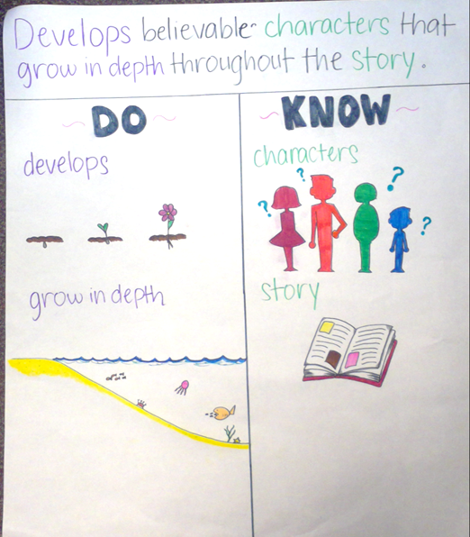
3. Instructional Focus
Unpacked assessments
Notes:
Meg’s Slide: “Physicalizing”; “Conceptual Framework”

Slide 7
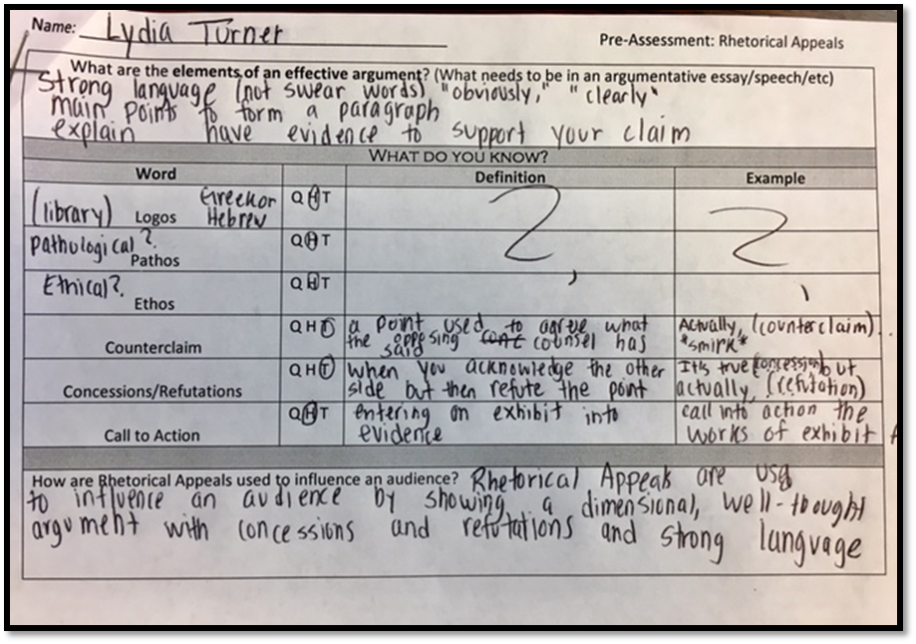
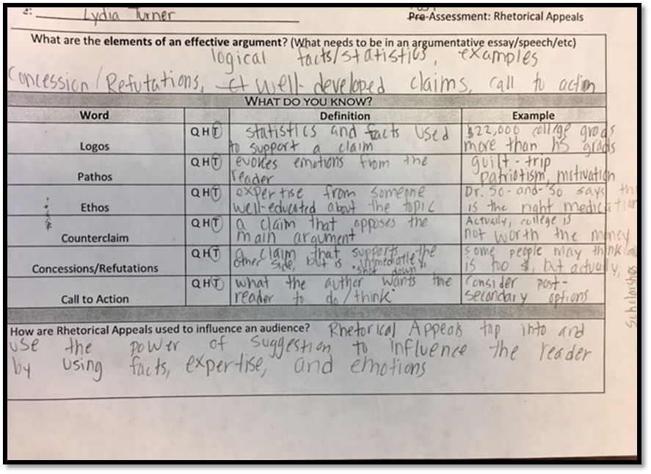

3. Instructional Focus
Pre and Post Assessments
Notes:
Meg’s Slide

Slide 8
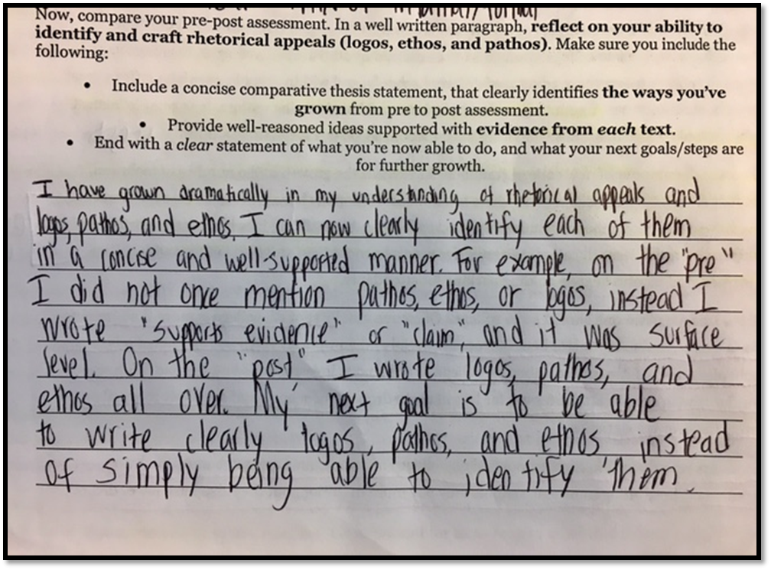
3. Instructional Focus
Pre and Post Assessments
Notes:
Meg’s Slide

Slide 9

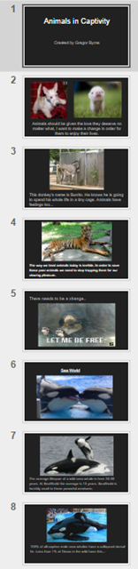
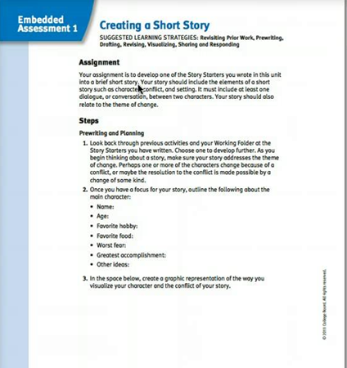
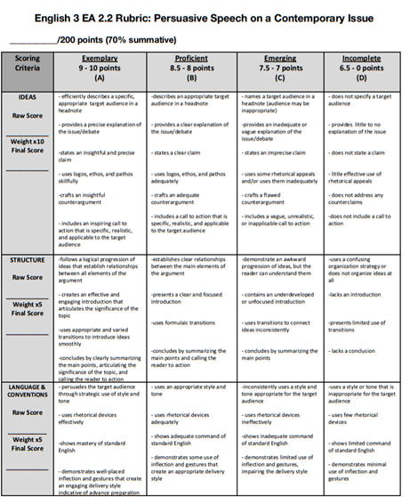
4. Assessment
SpringBoard Embedded Assessments Common Rubrics
Notes:
Meg’s Slide

Slide 10
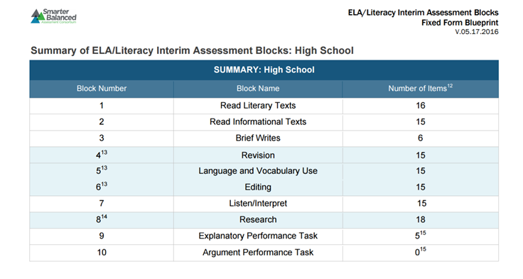
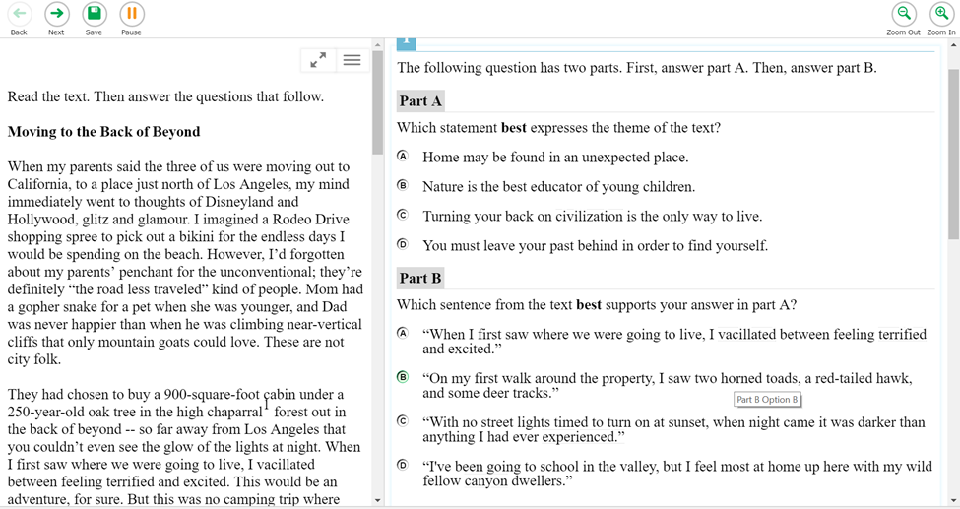
4. Assessment
SBAC Interim Assessment Blocks
Notes:
Jeniffer’s Slide

Slide 11



5 and 6. Tutorials and Enrichment
SBAC Boot Camp Poem in Your Pocket Nesika Library Events
Notes:
Jeniffer’s Slide

Slide 12
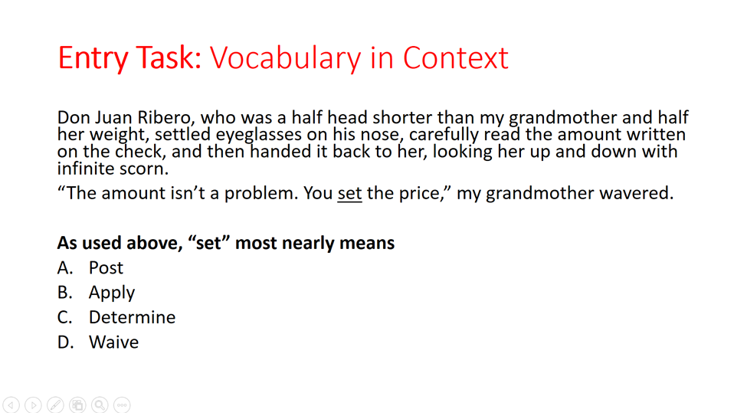
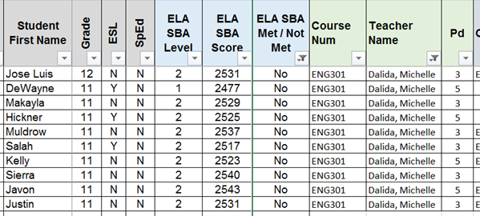
7 and 8. Maintenance and Monitoring
SAT/SBAC entry tasks Junior/Senior SBAC-Taker Lists
Notes:
Jeniffer’s Slide

Slide 13
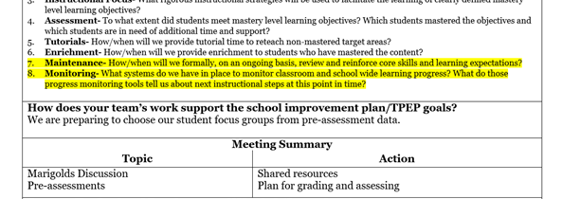
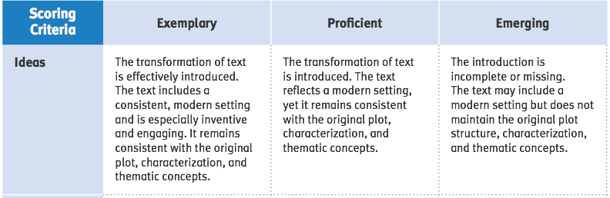
7 and 8. Maintenance and Monitoring
Common Assessments Data-Talk Decisions Around Monitoring
Notes:
Jeniffer’s Slide—persistent issues

